Slide 1

Dance recall
Pixel pioneers
tushit, Jai, suhani and yashash

Slide 2
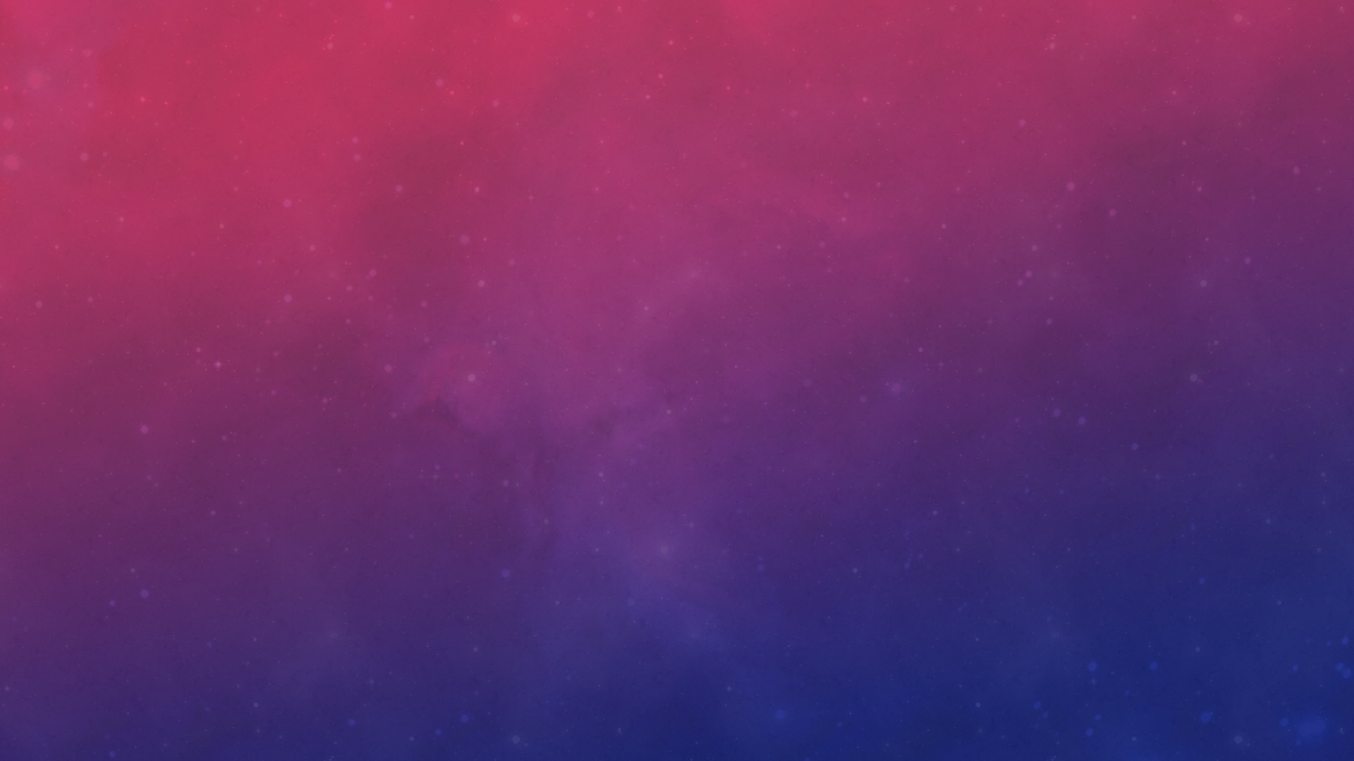
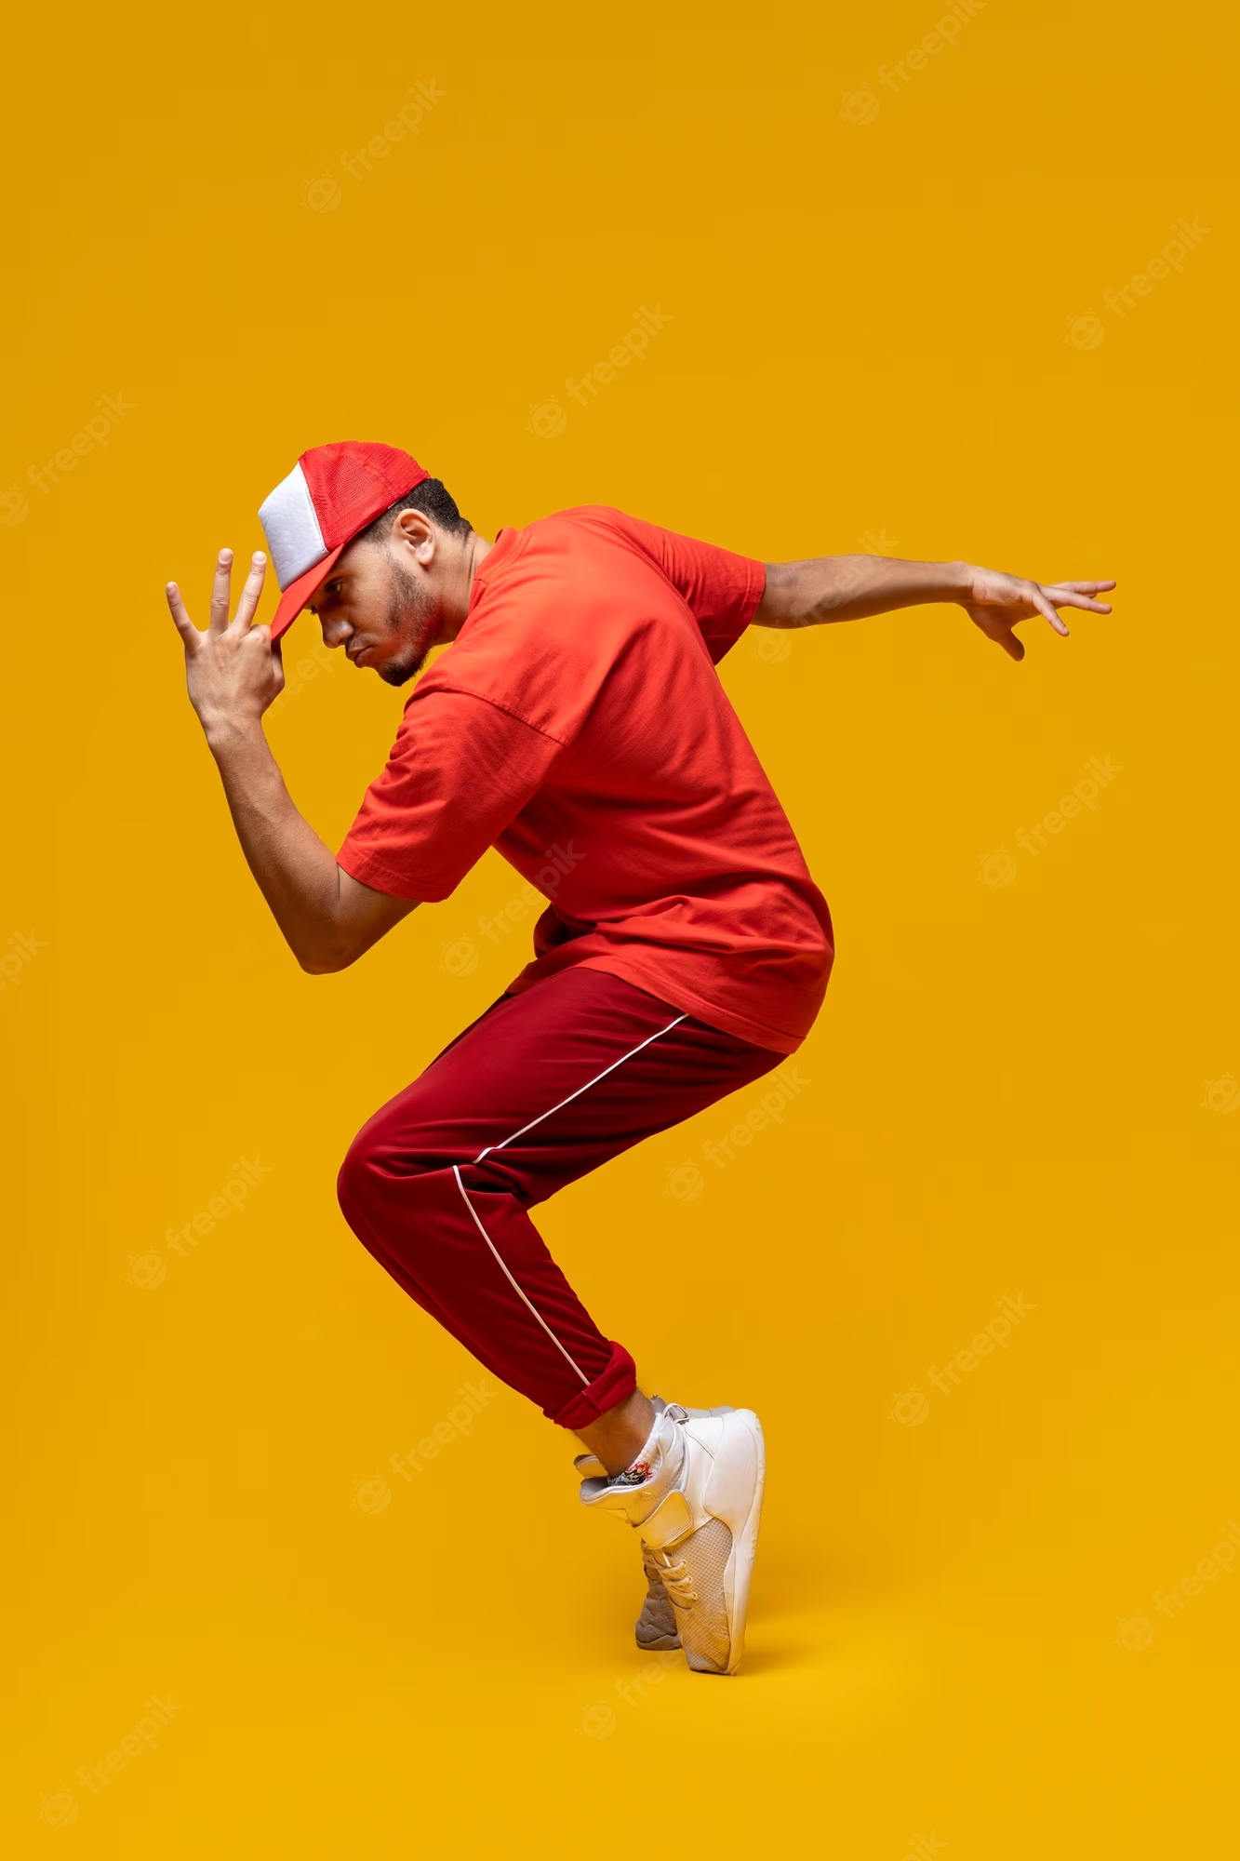
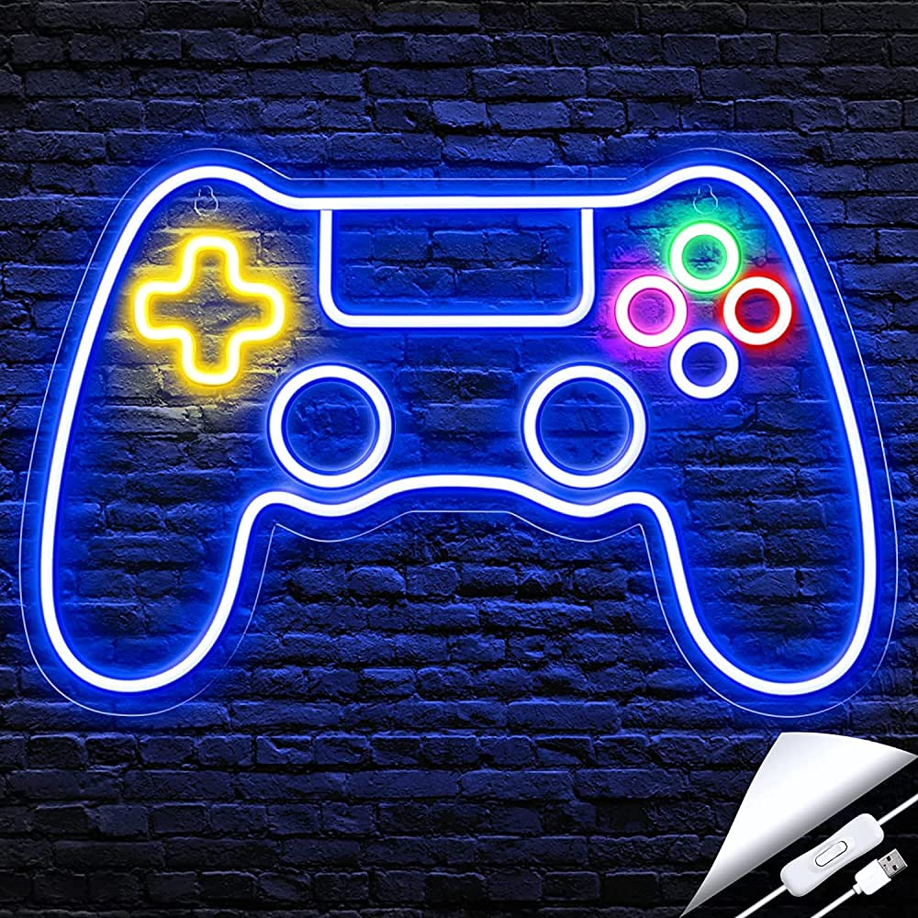
Reasons why you should play our game:
Visual Appeal
Relaxation and Stress Relief
Fun and Entertainment
Memory Improvement

Slide 3
Libraries and software we have used
Pygame
Tkinter
Blender
DaVinci Resolve

Slide 4

Thank You!

